Slide 1
CRAFT
TWG subGROUP 1 rootstock /scions
Brandon Page
OzGur Batuman
Greg Hodges

Slide 2
Cycle 1 trials
10 trials
plant material
  6 scion – Early Pride, Bingo, Star Ruby, Flame, Vernia, Valencia
  12 rootstocks - Sour, SuperSour 3, UFR 4, UFR 6, X 639, C 54, C 146, US 802, US 896, US 812, US 897, US 942, US 1281
Valencia on 9 rootstocks - C 54, C 146, UFR 4, UFR 6, US 812, US 897, US 942, US 1281, X 639
Star Ruby on SuperSour 3, US 802, US 897, US 942
Flame on SuperSour 3
Vernia on X 639, US 942, UFR 4
Early Pride on Sour
Bingo on Sour

Slide 3


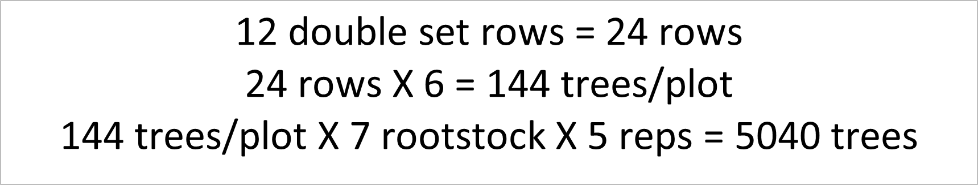

Slide 4
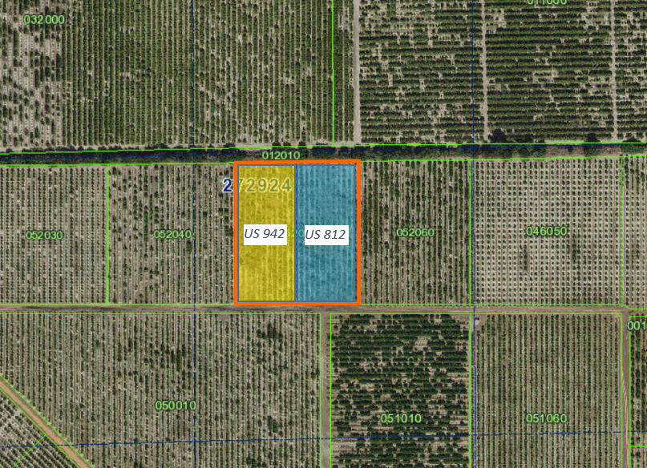

Slide 5
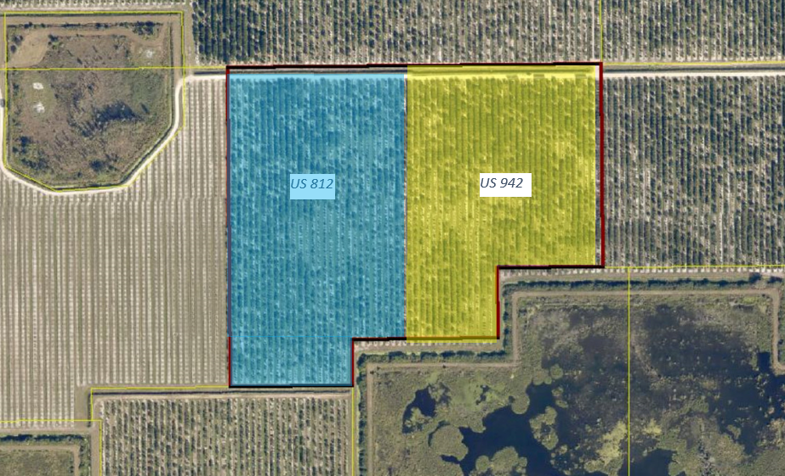

Slide 6
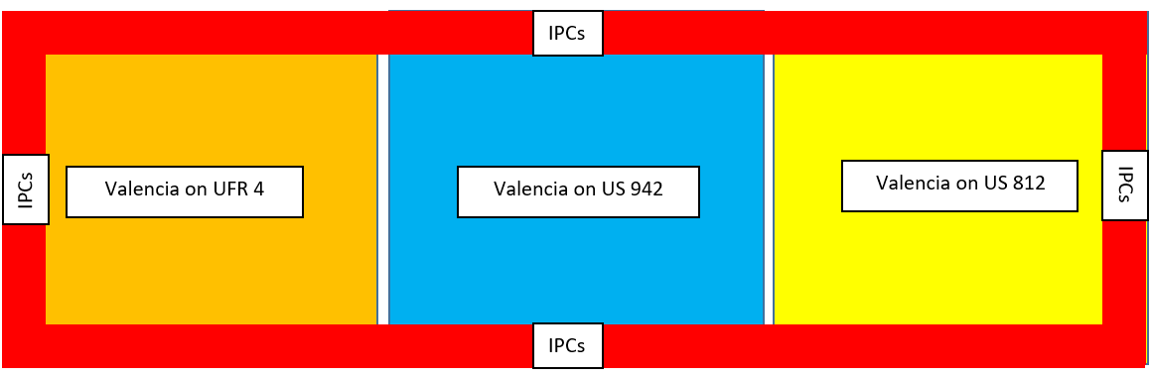

Slide 7
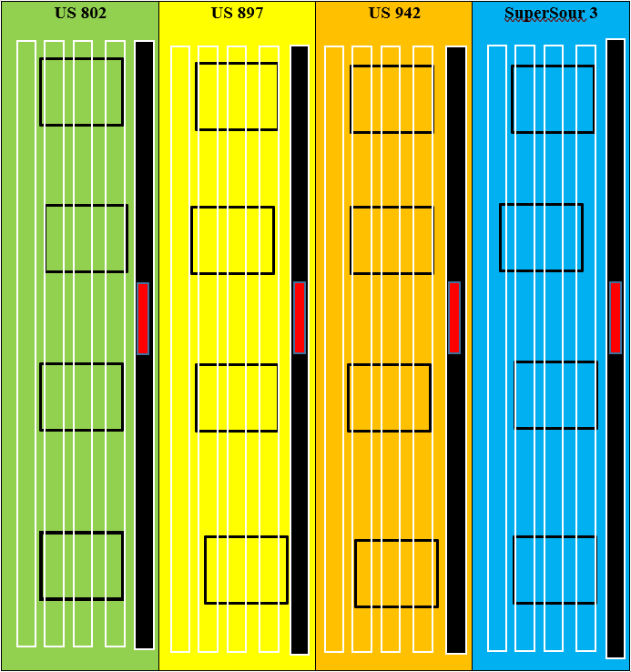

Slide 8
Trial designs
Agreed upon trial design
Single factor testing
2 factor testing
Rootstocks and Scion combinations
  One scion on multiple rootstocks
  One rootstock with multiple scions

Slide 9
Cycle 2
#1 Multilocation Trials
Scions
  Early and mids
    Vernia, Valquarius, EV 1, EV2, Hamlin
  Oll
  LB 8-9
  Sun Dragon
  Fresh Fruit
Rootstocks
  Traditional Rootstocks

Slide 10
Data Collection
Horticulture Measurements
  Height
  Diameter
  Volume
Plant samples
  PCR
  Nutrient samples
Yield and Quality !!!!!!!
  Thus the simplistic approach to the trial design

Slide 11
Applying for Cycle 2
What have you ordered from the nursery?
  Submit your tree order info
  Tell CRAFT what you want to evaluate
  Even if you don’t think there is a place in CRAFT for you, Apply!

Slide 12
Questions

