Slide 1
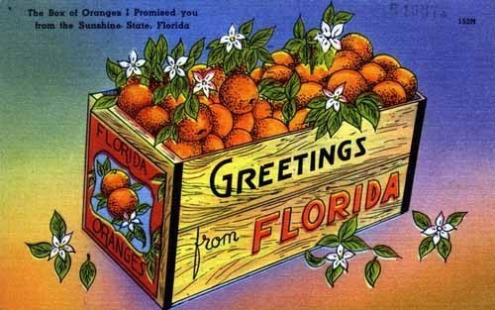
Working Group: CRAFT Reset Sub-Group
Brian Scully, Brandon Page & Bob Shatters

Slide 2
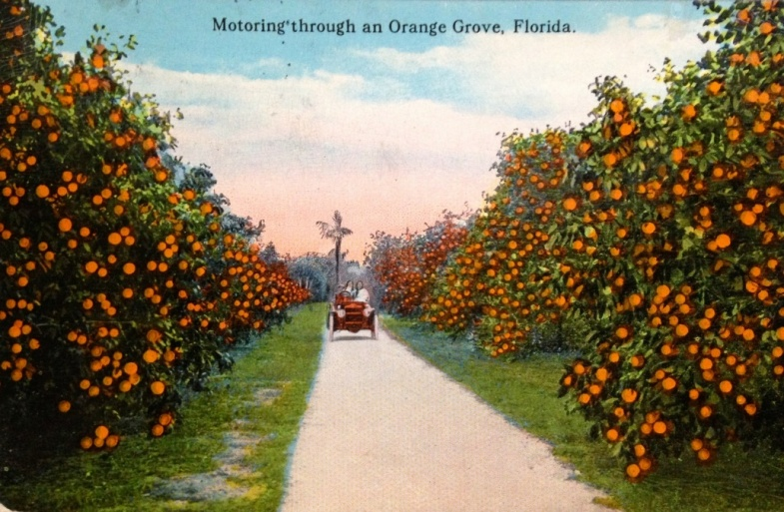
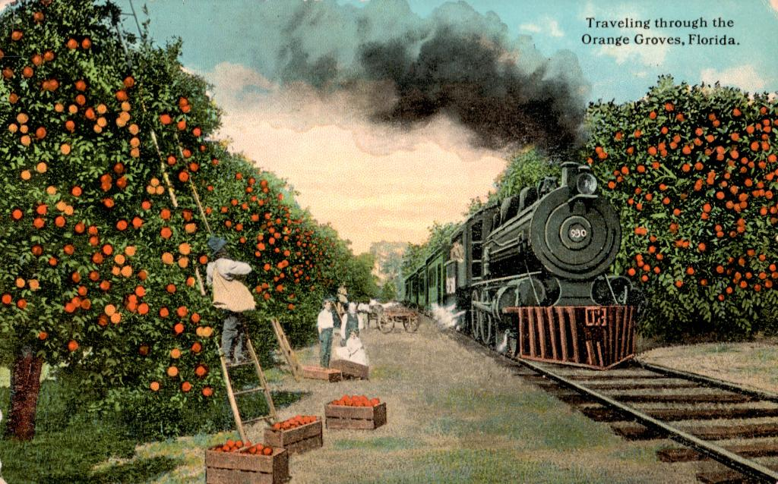
Reset Group Overview
Overview: The “Reset Project” is a specialized effort to rehabilitate an existing grove while concurrently retaining and improving the productivity of that grove. It transitions a grove incrementally to new cropping practices, technologies along with elite scion/rootstock replacements
Essentially, Redefine/Re-Invent the Citrus Cropping System
While maintaining profit and productivity without a “break-in-service” for the land

Slide 3
Reset Objectives
Whole Grove Performance
To monitor the productive of the whole grove using a time series analysis that simple compares annual yield and quality prior to participation (five seasons) in the program to grove performance upon entry into the program
These practices can be applied across both mature and young trees with appropriate controls for comparison.
Reset Performance
To compare the productivity & performance of a group or cohort of reset trees subjected to various treatment regiments

Slide 4
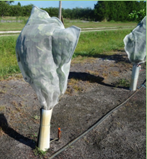
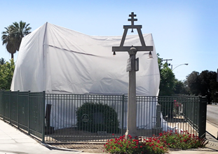
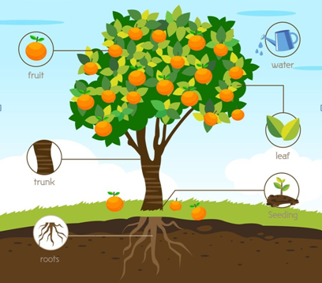
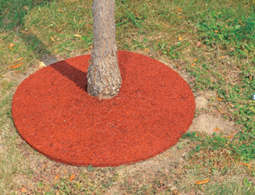
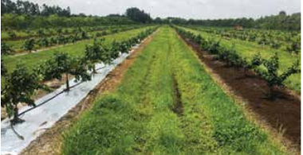
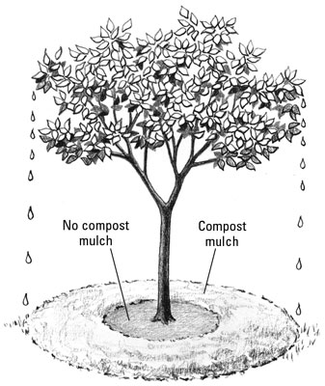
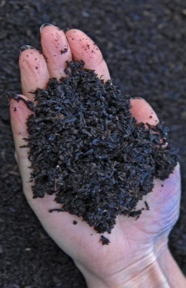
Reset Group: 4 Priorities
Acidified Irrigation H₂O
Protective Tree Covers
Organic Matter/Compost
“Reflective Donuts (New)
Acidified Irrigation Water
Individual Protective Tree Covers (IPC’S)
Compost for Resets
Metalized Reflective Donuts

Slide 5
Further Reset Guidelines
Group 4: Reset Group | Factor to be Tested | Rootstock/Scion preference | Location Preference | Potential Focus Factors
Reset Group Project 1 | Use of Acidified Water | Any | Any | Acidification vs no acidification
Reset Group Project 2 | Compare IPC projects not including bactericides | Any | Any | Comparing different IPC designs
Group 1 Project 3 | Compare use of compost treated with untreated | Any | Any | Comparison of soil amendments and probiotics
Group 1 Project 4 | Reflective donuts on individual trees vs no donuts | Any | Any | Evaluation of reflective mulch in reset setting

Slide 6
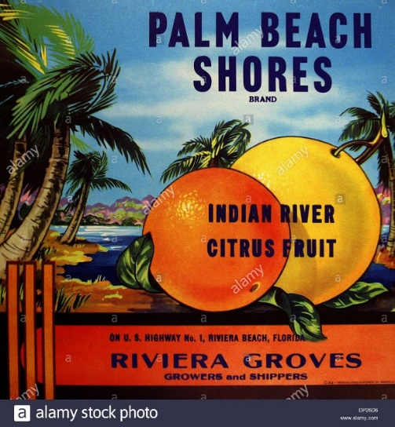
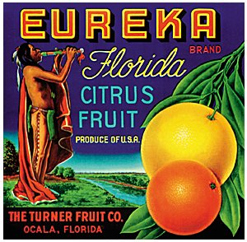
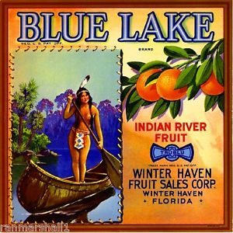
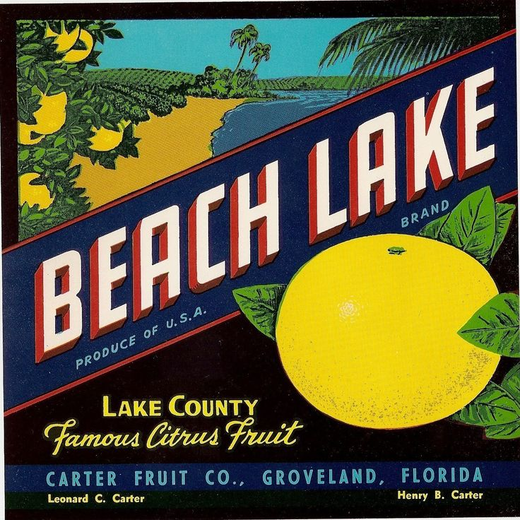
End of Reset Group Overview
Reset Group Breakout Session
Wednesday, June 24th
12:00 to 12:45

Slide 7
Questions in the Application
Passport information that will be in the Drop-Down Menu, and will be backed up on the Reset Spreadsheet
Contact Information
Year Block was Planted
Scion Rootstock Combination (Previous Records?)
Focus of Research: Recovery
Technical Working Sub-Group: Resets
Comparison: Previous Management
Ecological Region or Site Specific: Eco, Site or Both
Trial Design: Paired T-Test &/or Regression
Solid or Reset: Reset
Reset-Group Focus: 1) IPC’s; 2) Compost; 3) Donuts; 4) Acidification of Irrigation Water
County:
CRAFT App Number | CRAFT-2019-001R | CRAFT-2019-002R
Grower | Cody Estes (772)473-9251
Enterprise | Seibels Enterprises, Inc.
TWG Group | resets | resets
Focus of study | Recovery | Recovery
Comparison | Previous Mgmt | Previous Mgmt
eco region or site specific | Eco & Site | Eco & Site
trial design | Paired T-Test &/or Regression | Paired T-Test &/or regr4ssion
TWG Subgroup | Rehab/Resets | Rehab/Resets
subgroup focus | Grove & Subset tree performance | Grove & subset tree Performance
Reset or Solid set | reset | reset
County/Region | Polk/ Ridge | Hendry/SW

Slide 8
Series of Secondary Production Questions in the Application
Also in the Drop-Down Menu, and Backed up on the Reset Spreadsheet
Scion & Rootstock of Existing Grove & New Scion/Rootstock Combination
Current Trees/Acre and Intended Final Density
Fertilizer Practices: Assay and Annual Rate of1) Dry; 2) Fertigation; & 3) Foliar
Irrigation H₂O /soil acidification
Individual Protective Covers (IPC’s)
Particle Film (Kaolin Clays)
Windbreaks
HLB Products
Humic/Fulvic Acids
Other Root Treatments
Compost/Mulch (actually this is 2 Parts Now). A) Compost as Organic Matter; B) Reflective donuts
Foliar Diseases (Canker, PFD, Diplodia, etc)
Root Pathogens (Phytopthora)
Pest Control (# sprays/yr)

Slide 9
Let’s Get Complicated
Acidified Irrigation Water
Metalized Reflective Donuts
Considerations/Questions
Sulfuric Acid
Other Acids (Nitric)
Organic Acids
Concentrations
Dosing
Blends/Ratios
Additives (Nutrients)
Algae Control
Soil Type, toxicity, pH
Or just soil acidification
Considerations/Questions
Circumference
Other Shapes
Reflectivity
Herbicide Compatibility
Durability
Duration
Thickness
Irrigation Adjustments

Slide 10
Let’s Get More Complicated
Compost for Resets
Considerations/Questions
Type: Animal vs. Plant (FSMA)
BioChar, Molasses, Pongamia
Microbial Inoculation/Probiotics
Quantity/Frequency
Dry vs. Slurry
Additives (Nutrients)
Placement (&/or) Incorporation
pH adjustments
Individual Protective Tree Covers (IPC’S)
Considerations/Questions
Size/Shape/Design
Screen Mesh
Seal & Access
Duration & Swap-Out
Diseases & Pests Inside
Soil Insecticides
Spray Penetration

Slide 11
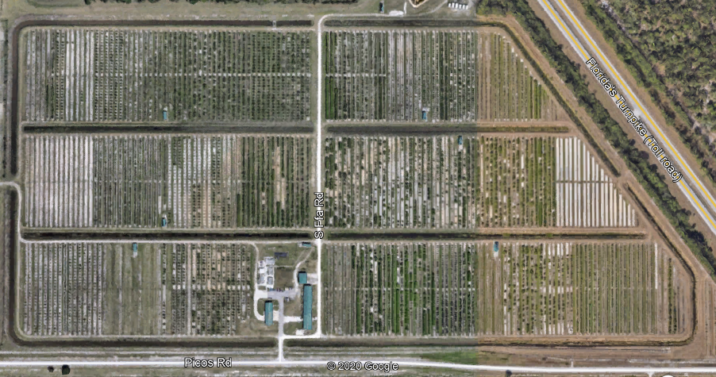
Example of the Experiment Map
(2 Factor Experiment)
Water Acidification
Control: No Acidification
Control: No Acidification
vs
Water Acidification
IPC’s vs. No IPC’s

Slide 12
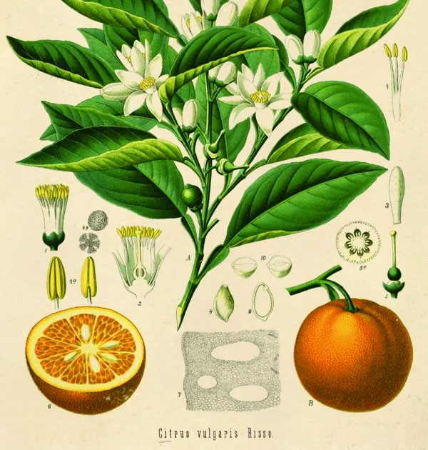
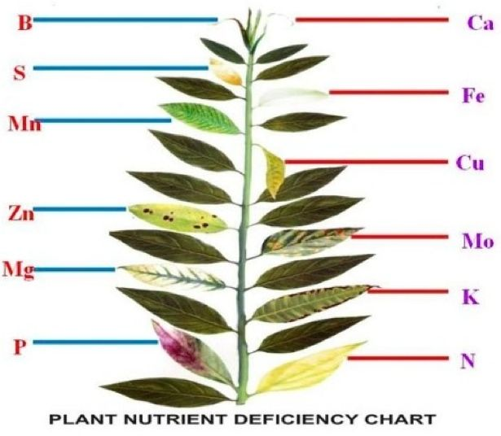
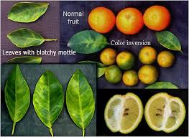
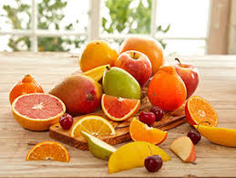
Questions and Discussion
“At the heart of science is an essential balance between two seemingly contradictory attitudes—an openness to new ideas, no matter how bizarre or counterintuitive they may be, and the most ruthless skeptical scrutiny of all ideas, old and new. This is how deep truths are winnowed from deep nonsense.” –Carl Sagan

