Slide 1
CRAFT Cycle Two: Breakout Session
GROUP THREE
PEST MANAGEMENT
Dr. Ozgur Batuman
Notes:
To change the image on this slide, select the picture and delete it. Then click the Pictures icon in the placeholder to insert your own image.

Slide 2
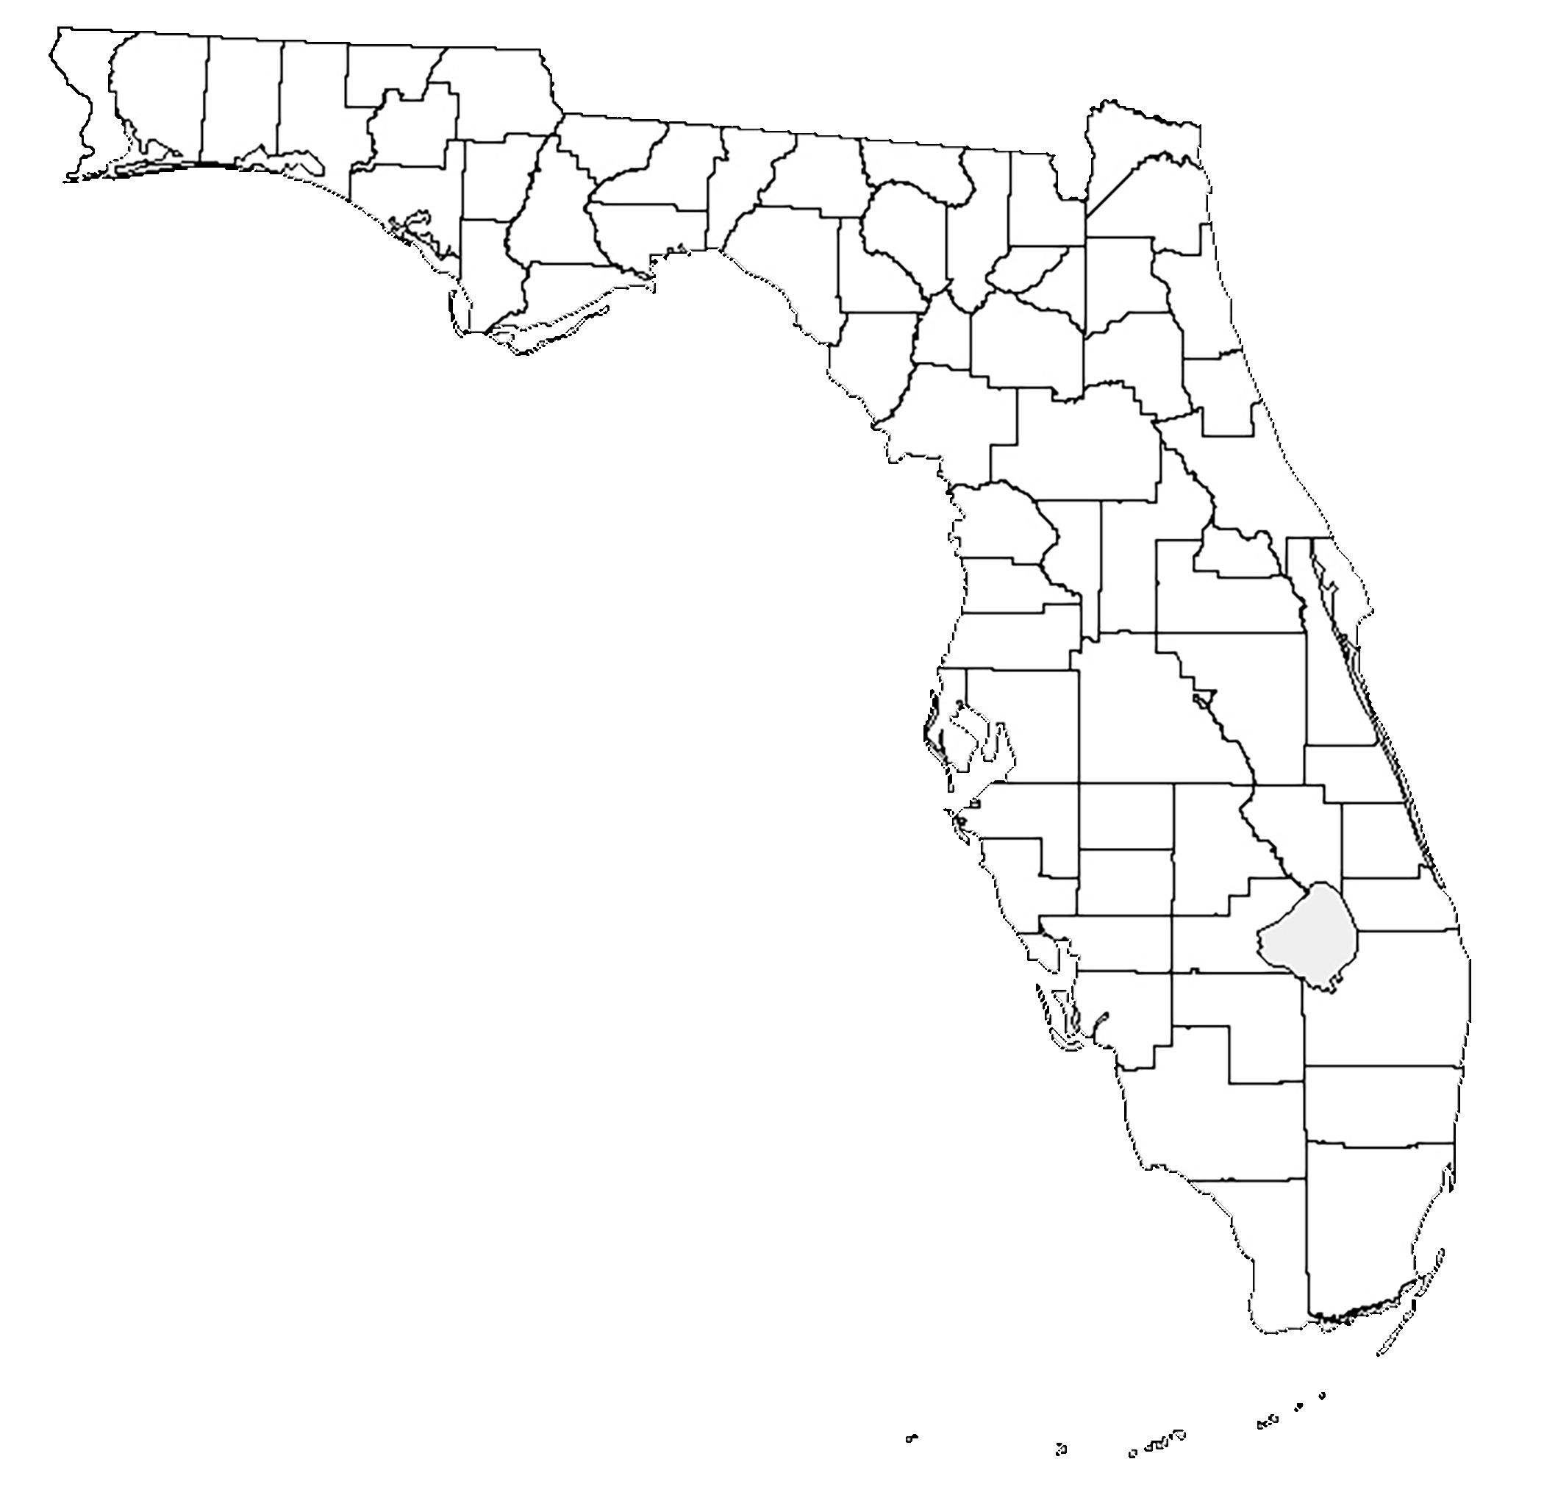
GROUP THREE: Program Participation
There were 10 CRAFT projects participating in the Pest Management Group in ‘cycle one’.
All projects were aiming to test novel strategies to control Asian citrus psyllids (ACP) in solid set groves.
All projects in this group finalized in terms of trial design and contract agreement.

Slide 3
GROUP THREE: Factors Tested
Three novel ACP control strategies are being tested:
Individual Protective Cover (IPC); 6 participants
Kaolin Clay Spray; 2 participants
Reflective/woven Mulch; 2 participants
APPLICATION NUMBER | FACTOR(S) TESTED | COUNTY | ACRES
CRAFT-2019-021S | Kaolin Clay | CHARLOTTE | 32
CRAFT-2019-024S | Woven mulch | INDIAN RIVER | 40
CRAFT-2019-029S | Reflective Mulch | POLK | 10+10
CRAFT-2019-036S | IPC | POLK | 27
CRAFT-2019-037S | IPC | POLK | 20
CRAFT-2019-038S | IPC | GLADES | 32
CRAFT-2019-039S | IPC | HARDEE | 20
CRAFT-2019-042S | IPC | INDIAN RIVER | 20
CRAFT-2019-049S | Kaolin Clay | HARDEE | 20
CRAFT-2019-052S | IPC | HIGHLANDS | 42
 |  | Total | 266

Slide 4
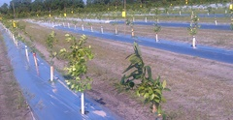
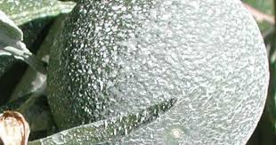
GROUP THREE: Factors Tested
Three novel ACP control strategies are being tested:
Individual Protective Cover (IPC); 6 participants
Kaolin Clay Spray; 2 participants
Reflective Mulch; 2 participants
Rationale:
HLB management currently heavily rely on chemical control of ACP in citrus groves
Repetitive use of insecticides is not sustainable and selects insecticide-resistant ACP populations
Effective and alternative ACP control strategies are urgently needed in Florida.

Slide 5
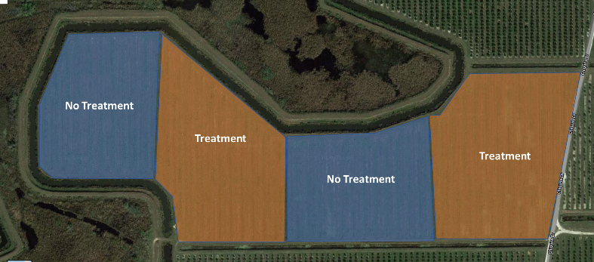
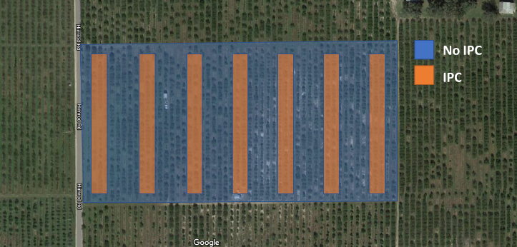
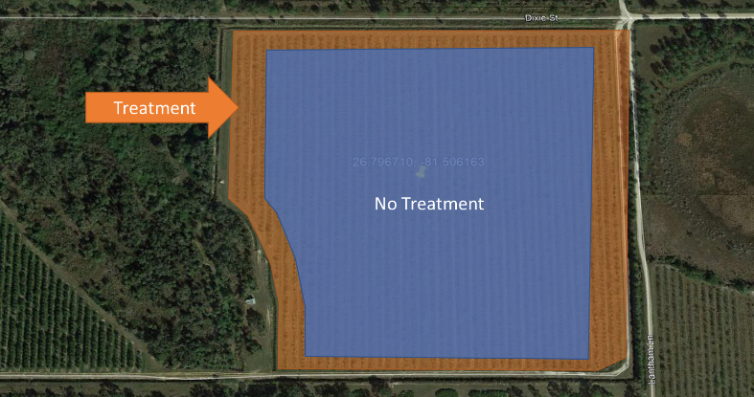
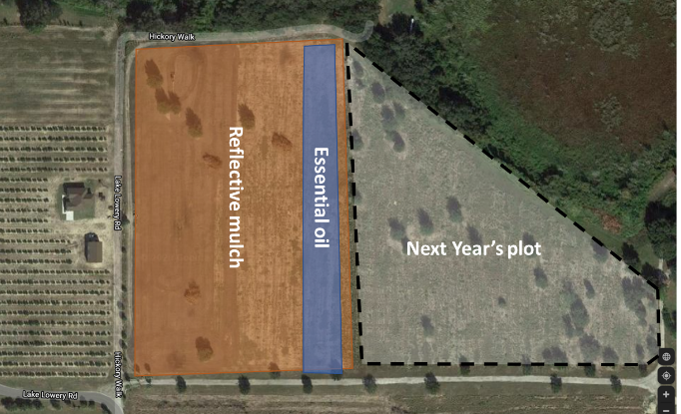
GROUP THREE: Trial Design Examples

Slide 6
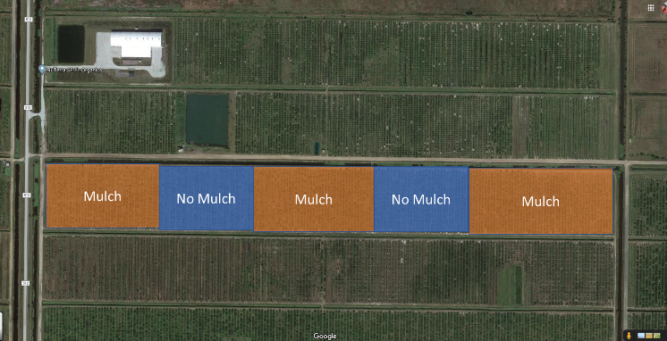
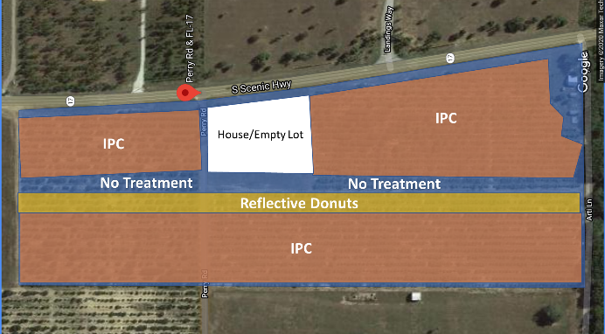
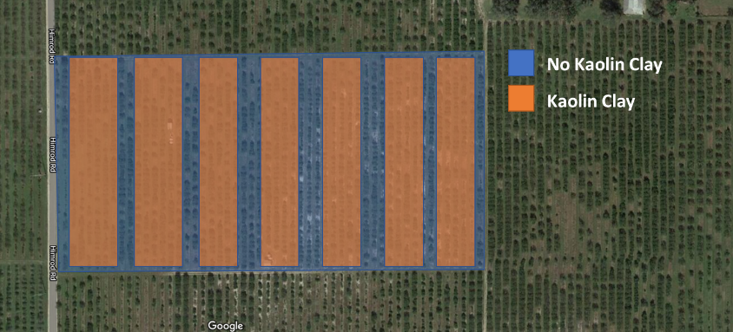
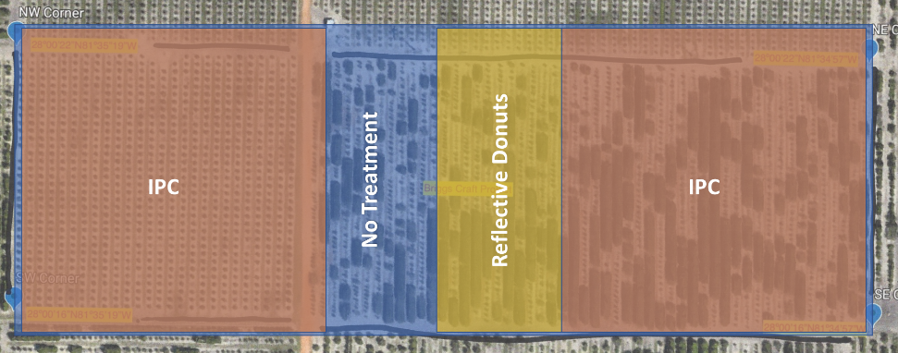
GROUP THREE: Trial Design Examples

Slide 7
GROUP THREE: Gaps and Possible New Areas to Explore in Cycle Two
Main Gap: Integration of strategies
Use of multiple strategies in combination to control ACP as well as improving plant health (nutrition, irrigation and IPM).
For example: Use reflective mulch but also consider using compost, balanced nutrition regiments and/or slow-release fertilizer as well as protect your trees from other pests and pathogens with timely pesticide applications.

Slide 8
GROUP THREE: Gaps and Possible New Areas to Explore in Cycle Two
New/potential areas to consider in ‘Pest Management’ group
ACP Chemical, biological & physical controls: Parasitic wasp Diatomaceous earth
HLB Use of antimicrobials, plant defense or systemic acquired resistance (SAR) inducer compounds Use of novel therapeutic delivery techniques
SECONDARY PESTS Canker, PFD, CBS and Phytopthora etc. Foliar fungicides and bactericides Citrus tristeza virus (CTV), and Aphid control etc.

Slide 9
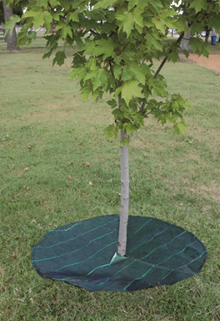
GROUP THREE: Gaps and Possible New Areas to Explore in Cycle Two
Any other Suggestions?
Trials are in only 7 counties; how about in other counties or on different scion/rootstocks?
??
??
scion | rootstock
Vernia | 802
Star Ruby | 942
Page | 802
Vernia | 639
Valencia | Rough Lemon
Vernia | 942
Vernia | 802
Flame | Sour
Valencia | 942

